Slide 1
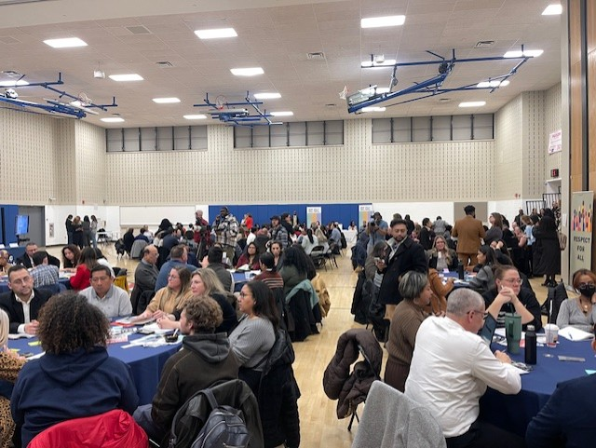
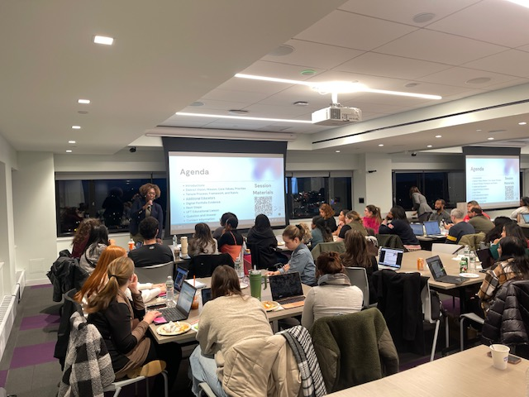

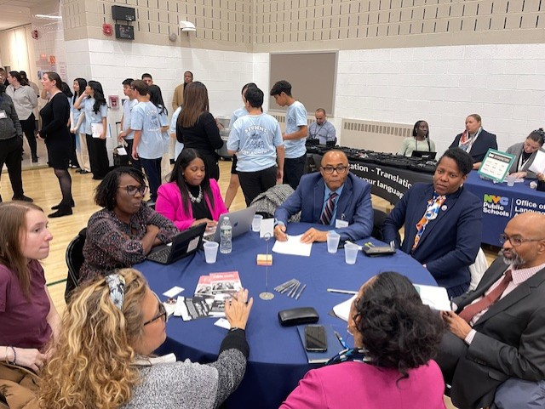
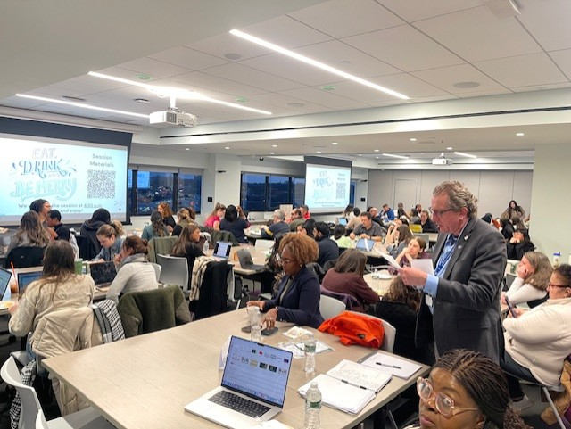
Literacy Proficiency
Math Proficiency
Chronic Absenteeism & Retention
Parent Engagement
Community
Superintendent
Dr. Eric L. Blake
Deputy Superintendent
Dr. Shonelle Hall
December 5, 2024
“With effort and support all schools can meet the needs of their students and help them achieve outstanding educational outcomes”

Slide 2
District 28 Vision, Mission & Goals
The United Nations' mission statement includes the line, "In this noble undertaking, cooperation, collaboration, unity, and solidarity must be the light we should seek and follow. We commit to strive for inestimable contribution to human progress."
Mission
In Community School District 28 we focus on equity as a lever for achievement for every single scholar. We are a district of excellence. We commit to every school maintaining high academic standards and working closely with families so that all scholars are learning at high levels. Beginning with school leaders, teachers, students and community partners, we also commit to being a district of learners ensuring that we promote critical thinking rooted in core content conceptual understanding through creative problem solving, technology innovation, social emotional learning and community advocacy.
Vision
In Community School District 28 we celebrate our differences because we understand that woven into those differences is the knowledge that they offer us unlimited possibility to learn and expand our knowledge of and commitment to all humanity. We are beautifully diverse, varied; coming from countless racial, ethnic, language, and belief backgrounds. We commit to striving for inestimable contribution to the lives of our scholars.

Slide 3
Overview of the C-30 process
Regulation of the Chancellor
Number: C-30
Subject: REGULATION GOVERNING THE SELECTION, ASSIGNMENT AND APPOINTMENT OF PRINCIPALS AND ASSISTANT PRINCIPALS

Slide 4
Overview of the C-30 process
What is the C-30 Process?
The C-30 process is a set of guidelines and steps for selecting and appointing school leaders.
It ensures the process is fair, transparent, and based on merit.

Slide 5
Key steps in the C-30 process
Vacancy Announcement: Posting of the position on the DOE website.
To enable potential candidates to learn of vacancies and have reasonable time to submit applications, vacancies will be posted a minimum of 15 calendar days. Application Submission: Candidates apply through the DOE portal.
Level I Committee: Initial review and interviews by a committee.
Level II Committee: Further review and final interviews.
SLT Consultation: School Leadership Team provides input.
Final Appointment: Approval and appointment of the selected candidate.

Slide 6
C-30 Level 1 Committee
Comprised of school staff, parents, and community members.
Reviews applications and conducts initial interviews.
Recommends candidates for Level II.

Slide 7
Level 2 Committee
Includes higher-level DOE officials.
Conducts final interviews and makes the final selection.
Ensures candidates meet all qualifications and standards.

Slide 8
SLT Consultation
SLT reviews the final candidate.
Provides feedback and ensures community input is considered.
Helps finalize the appointment decision.

Slide 9
Final Appointment
The selected candidate is vetted and approved by the DOE.
Official appointment is made.
Announcement to the school community.

Slide 10
District 28 Special Education Highlights
District 28 is currently at 95%
The city is currently at 88%
Related Service Mandates
The district is currently at 97%

Slide 11
Professional Development / Training
Teachers and Paraprofessionals continue to receive training for Autism, FBA/BIP, Instructional and Behavior Supports through Central and district professional learning
Training initiative for Paraprofessionals: Registered Behavior Technicians (RBT)
  Exposure to strategies from Applied Behavior Analysis (ABA) that can effectively address some of the behavioral, social, and language needs of our students
Ongoing training to staff and paraprofessionals such as TCIS: Therapeutic Crisis Intervention for Schools
Ongoing district learning to special education liaisons by our ASE and SSSL
In-school instruction and compliance supports to maximize student outcomes
In-school supports with behavior crises

Slide 12
Special Education Program Offerings
Integrated Co-teaching (ICT)
Special Class
ASD Programs (Nest, Horizon)
Opening of a Kindergarten Bilingual Special Education Program at 28Q086 in September SY 2024-25
Anticipate extended opening of two additional Kindergarten Bilingual Special Education Programs in SY 2025-26
Collaborating with Central Special Education office to open more ASD Programs in SY 2025-26
Collaborating with Central Special Education office to consider opening an ACES Program in D28. Closest programs currently in District 27 and Brooklyn

Slide 13
Chancellor’s Listening Tour
The Chancellor wanted to hear from the Queens community on how to make NYC Public Schools even better. Stakeholders were able to share their thoughts about education around school safety, access to resources, and support for staff and community members.

Slide 14
D28 Attendance Snapshot
DCEP - Attendance Goals
By June 2025, we will increase district-wide attendance by 2 percentage points from 90.7% to 92.7% excluding students who are long-term international travelers.
By June 2025, we will reduce overall chronic absenteeism by 10% of overall Chronically Absent Students EOY 23/24 from 35% to 31%, excluding students who are long-term international travelers.
Where are we Now: 12/03/24
YTD Overall Attendance: 92.3% vs 91.0% Citywide
Chronic Absenteeism YTD: 24.5% vs 27.9% SAME DATE LAST YEAR, representing an overall decrease of 12.18% :)
28/35 D28 Schools showing improvement in CA vs same date last year
25/35 D28 Schools outperforming Citywide average of 91% daily attendance

Slide 15
    Happy Holidays
As we approach the holiday season, we want to extend our warmest wishes to everyone. May this time be filled with joy, peace, and cherished moments with loved ones. We hope you have a wonderful and restful holiday break, and a joyful and prosperous New Year filled with new opportunities and continued success!

